Slide 1
More Data Modelling principles
Martin Read

Slide 2
Determinacy & Dependency
Determinant
In a relation, an attribute or group of attributes that determine the value of one or more other attributes.
An attribute A is said to be a determinant of attribute B if a given value of A is associated with just one value of B at any given time
A is the determinant of B,
B is functionally dependent upon A

Slide 3
Determinacy & dependency
If given a value for Customer No we can be certain of getting a unique value for Customer Name
then Customer No is a determinant of Customer Name
Customer Name is dependent on Customer No
Keys must be unique valued across the range of possible values

Slide 4
Determinacy & dependency
Student
No
Student
Name
Student No determines Student Name (a Simple key)
Student No
Module No
Mark-obtained
Student No and Module No together determine
Mark obtained (a Compound key)

Slide 5
Exclusive Relationships
Exist when the participation of an entity occurrence in one relationship precludes it from participating in another
Allows for the modelling of shared relationships
a given occurrence can only be a member of a single relationship
This is shown by an arc on the relationships which are exclusive
Exclusive relationships must be of the same type
(order and optionality)

Slide 6
Exclusive Relationships
Each Account must be allocated to one and only one Client OR to one and only one Company
Each Client may be the holder of one or more Accounts
Each Company may be the holder of one or more Accounts

Slide 7
Exclusive Relationships
This means that an Order consists of either one or more Products or one or more Services but NEVER a combination
Order
for
for
listed on
listed on
Product
Service

Slide 8
Exclusive Relationships
DISTRICT
ESTATE
APPLICATION
selected as
selected as
detailed with
stated as
Exclusive OR arc
stated as
expressed in
TENANT
PREFERENCE

Slide 9
Exclusive Relationships
APPLICATION
super-type of
super-type of
Exclusive OR arc
sub-type of
sub-type of
NEW
APPLICATION
TRANSFER
APPLICATION

Slide 10
Entity Aspects (1)
Vehicle has two Aspects
Vehicle
Vehicle-Rental
Vehicle-
Maintenance
Representation of an Entity in different Sub-systems
(can be used to break down large data structures)
“Aspect” is used to indicate views of an entity where it plays one or more roles in a diagram. May represent a sub-system (i.e. a collection of entities performing a ‘role’)

Slide 11
Entity Aspects (2)
Vehicle has two Aspects
Vehicle
Maintenance
sub-system
Client
Vehicle-Rental
Vehicle-
Maintenance
Rental
sub-system
Rental
Service

Slide 12
Entity Aspects (3)
Client
Vehicle-Rental
Vehicle-
Maintenance
Rental
Service
An alternative notation uses a straight line between the two aspects

Slide 13
Entity Sub-types & Super-types
If the shared relationships are 1:1 indicates sub-types of an entity
Entity super-type
containing
sub-types
Sub-types are mutually exclusive

Slide 14
Entity Sub-types
sub-types with
exclusive arc
Alternative
notation

Slide 15
From the below scenario, look for possible entities – answers on next slide.
People looking for rented accommodation provided by the local council can make one or more applications. Applications are of two kinds. If the prospective tenant is not already in a council property, they will complete a new application with full personal details. If they are already a tenant, they can apply to transfer to a different property. (This might be necessitated by a change in personal circumstances such as starting a family.) Tenants can state a number of preferences in an application for the location of a property. Each preference must be stated for either a district or an estate. Estates are always wholly located within a district (although a district may not necessarily have any estates within it).

Slide 16
Below are possible entities, now construct an ERD – possible solution on next slide.
People looking for rented accommodation provided by the local council can make one or more applications. Applications are of two kinds. If the prospective tenant is not already in a council property, they will complete a new application with full personal details. If they are already a tenant, they can apply to transfer to a different property. (This might be necessitated by a change in personal circumstances such as starting a family.) Tenants can state a number of preferences in an application for the location of a property. Each preference must be stated for either a district or an estate. Estates are always wholly located within a district (although a district may not necessarily have any estates within it).

Slide 17
Tenant
Application
District
New
Application
Estate
Transfer
Application
Tenant
Preference

Slide 18
One-to-Many Recursive Relationship
An occurrence of an entity can have relationship with another occurrence of the same entity
E.g. Each employee (Manager) may be managing one or more employees
Each employee must be managed by one and only one employee (Manager)

Slide 19
Recursive Relationship - Hierarchic
Regional
Manager
NOTE: Exclusive OR arc
Director
responsible for
responsible to
Area
Manager
==>
responsible to
Manager
responsible for
District
Manager
A manager is also an employee and may be managed by another employee (manager)

Slide 20
Many-to-Many Recursive Relationship
Each product may be a substitute for one or more products
Each product may be substituted by one or more products

Slide 21
Many-to-Many Recursive Relationship
Resolved using a link entity Product Substitution
Possible attributes associated with the link entity are price adjustment and equivalent quantity

Slide 22
Recursive Relationship - Network
Sub-assembly
used within
==>
used as
made up of
Sub-assembly
made up of
for the use of
on the parts list of
Many-to-many recursive relationship
Standard
Component
Resolved as two one-to-many relationships with a new associative entity (labels are important here)

Slide 23
Recursive relationships
An entity has a relationship with itself
Hierarchic, as in layers of management where each manager manages a set of managers (a 1:m degree of relationship)
Consists of a master entity and a “pig’s ear” with a one-to-many relationship
Network, as in a Bill of Materials (BOM) where a part can be made up of components, & the part itself can be a component for a larger assembly (an n:m degree of relationship)
Best expressed as two entities with multiple relationships between them

Slide 24
Research Papers system
From the below scenario, look for possible entities – answers on next slide.
A University Library has a cataloguing system for Research Papers contained in various issues of Research Journals. The journals have particular subject areas such as Computing. Each journal contains a number of research papers and each paper may relate to a specific field of the subject such as Artificial Intelligence. The paper may have one or more authors each of whom may contribute to other papers in many different journals. The papers normally contain references to other papers. Each paper can only be published once, in a single issue of one journal. An issue of the journal is identified by its title, volume and issue number (or title, year and month).

Slide 25
Research Papers system
Below are possible entities, now construct an ERD – possible solution on next slide.
A University Library has a cataloguing system for Research Papers contained in various issues of Research Journals. The journals have particular subject areas such as Computing. Each journal contains a number of research papers and each paper may relate to a specific field of the subject such as Artificial Intelligence. The paper may have one or more authors each of whom may contribute to other papers in many different journals. The papers normally contain references to other papers. Each paper can only be published once, in a single issue of one journal. An issue of the journal is identified by its title, volume and issue number (or title, year and month).

Slide 26
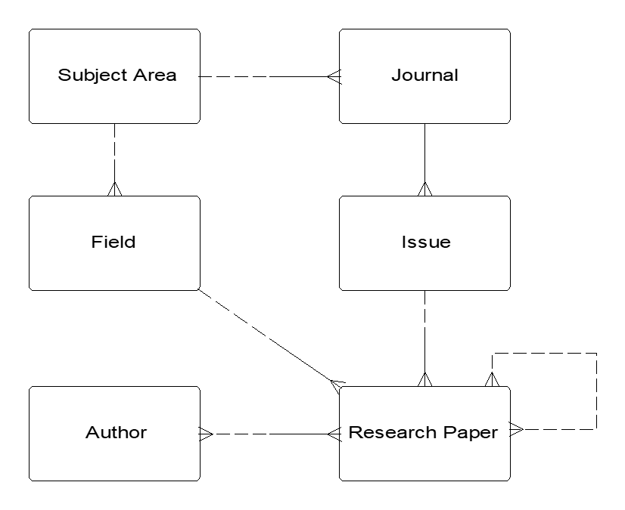
1st pass ERD

Slide 27
Initial ERD

Slide 28
Summary
Introduction to some more principles of data modelling
Determinacy & Dependency
Exclusive Relationships
Recursive relationships

